Slide 1

Data Mining K-Nearest Neighbor (KNN)
Data Mining
Dr. Sajarwo Anggai, S.ST., M.T. NIDN : 0421108703

Slide 2
Data Mining : Pertemuan 4
Menyiapkan data training
Algoritma KNN
Evaluasi Model
Tugas

Slide 3
Data Training
Siapkan data training dalam bentuk excel atau csv yang nantinya akan di load ke dalam Aplikasi.
Data dapat diambil di dalam negeri maupun luar negeri atau dibangun sendiri sesuai dengan kebutuhan.

Slide 4
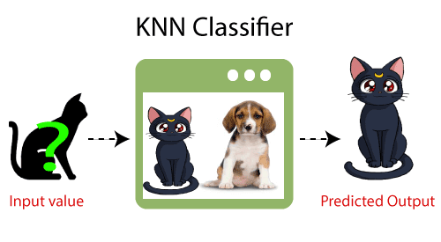
KNN
K-NN algorithm:
Step-1: Select the number K of the neighbors
Step-2: Calculate the Euclidean distance of K number of neighbors
Step-3: Take the K nearest neighbors as per the calculated Euclidean distance.
Step-4: Among these k neighbors, count the number of the data points in each category.
Step-5: Assign the new data points to that category for which the number of the neighbor is maximum.
https://www.javatpoint.com/k-nearest-neighbor-algorithm-for-machine-learning

Slide 5
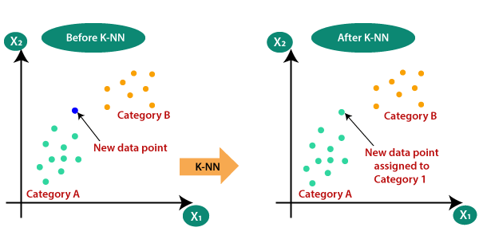
KNN
https://www.javatpoint.com/k-nearest-neighbor-algorithm-for-machine-learning

Slide 6
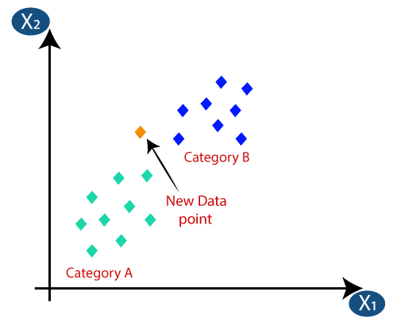


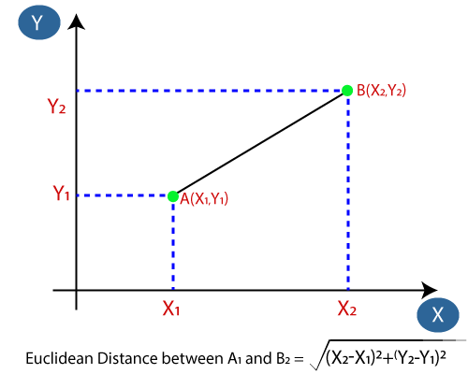


KNN
Euclidean Distance
Manhattan Distance
Minkowski Distance
Chebyshev Distance
https://www.javatpoint.com/k-nearest-neighbor-algorithm-for-machine-learning

Slide 7
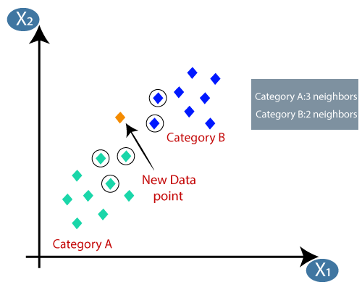
KNN
https://www.javatpoint.com/k-nearest-neighbor-algorithm-for-machine-learning

Slide 8
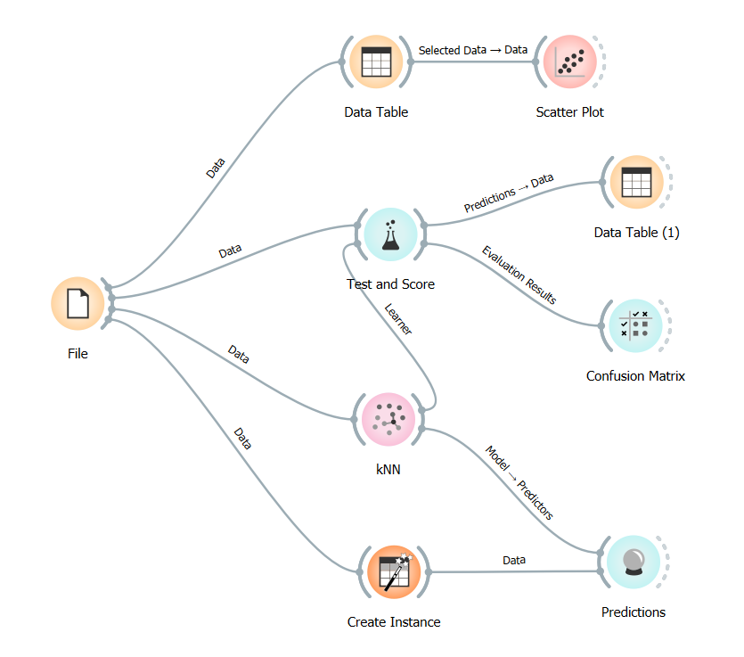
Contoh 1

Slide 9


Contoh Ilustrasi KNN
https://www.youtube.com/watch?v=0p0o5cmgLdE
https://www.youtube.com/watch?v=4HKqjENq9OU

Slide 10
Tugas
Buat Model untuk KNN
Kelebihan dan Kekurangan KNN
Cari 10 Jurnal terkait pemanfaatan KNN
Diskusikan dalam Forum
Tuliskan dalam laporan (dikumpulkan saat UTS)

Slide 11
Referensi Bacaan Tambahan
https://www.javatpoint.com/k-nearest-neighbor-algorithm-for-machine-learning
https://www.freecodecamp.org/news/k-nearest-neighbors-algorithm-classifiers-and-model-example/
https://www.geeksforgeeks.org/k-nearest-neighbours/
https://www.trivusi.web.id/2022/06/algoritma-knn.html
https://medium.com/bee-solution-partners/cara-kerja-algoritma-k-nearest-neighbor-k-nn-389297de543e

Slide 12

Universitas Pamulang
Magister Teknik Informatika
Sajarwo Anggai
Dosen – Universitas Pamulang
NIDN : 0421108703
Email : dosen02832@unpam.ac.id
WA : 082343006557
Terima Kasih

